Slide 1
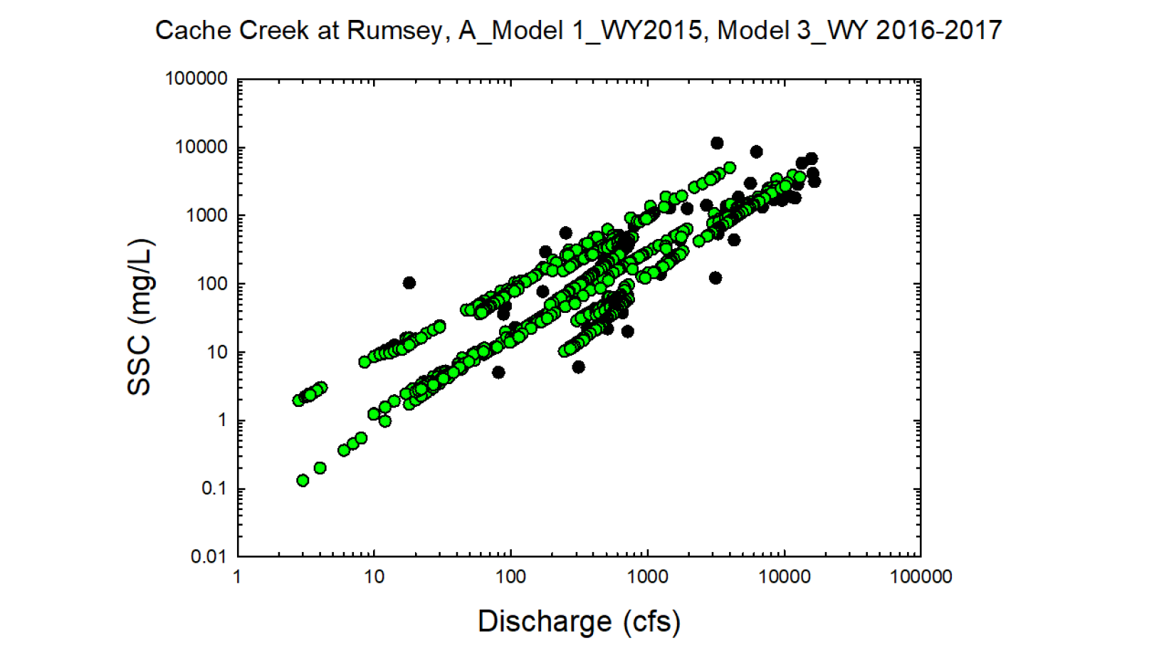
Black circles = Observed values
Green circles = Modeled values

Slide 2
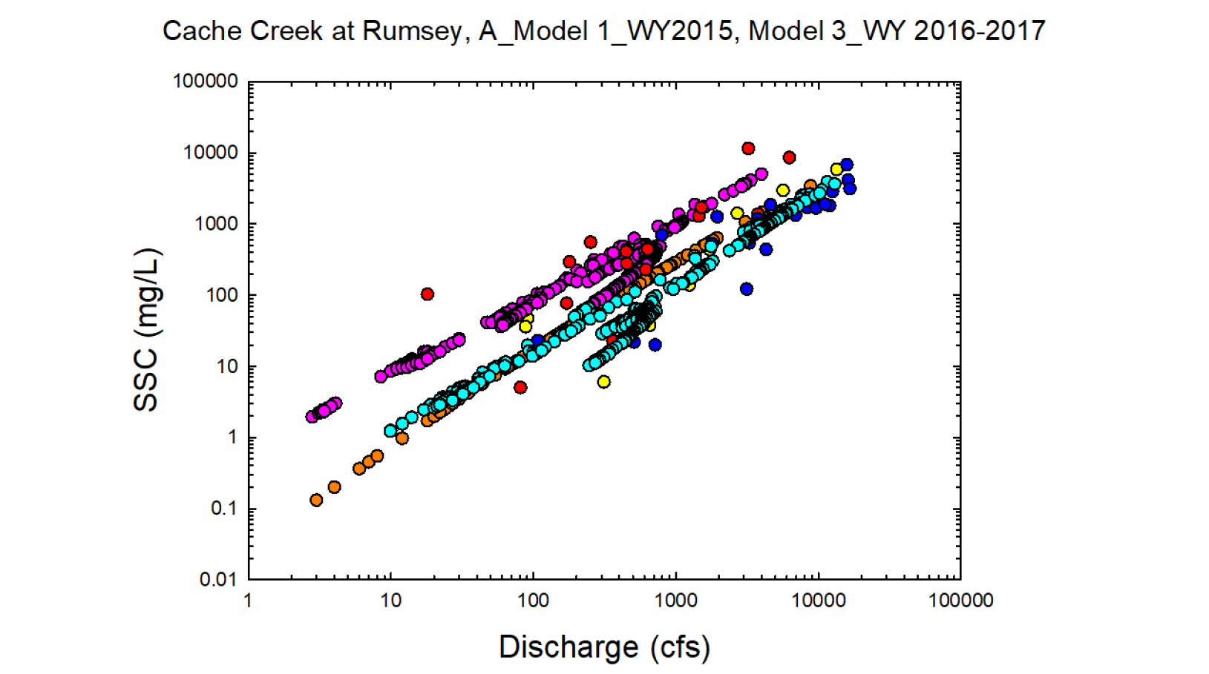
Yellow = Observed wy 2015
Red = Observed wy2016
Dk. Blue = Observed wy2017
Orange = Modeled wy2015
Pink = Modeled wy2016
Lt. Blue= Modeled wy2017

Slide 3
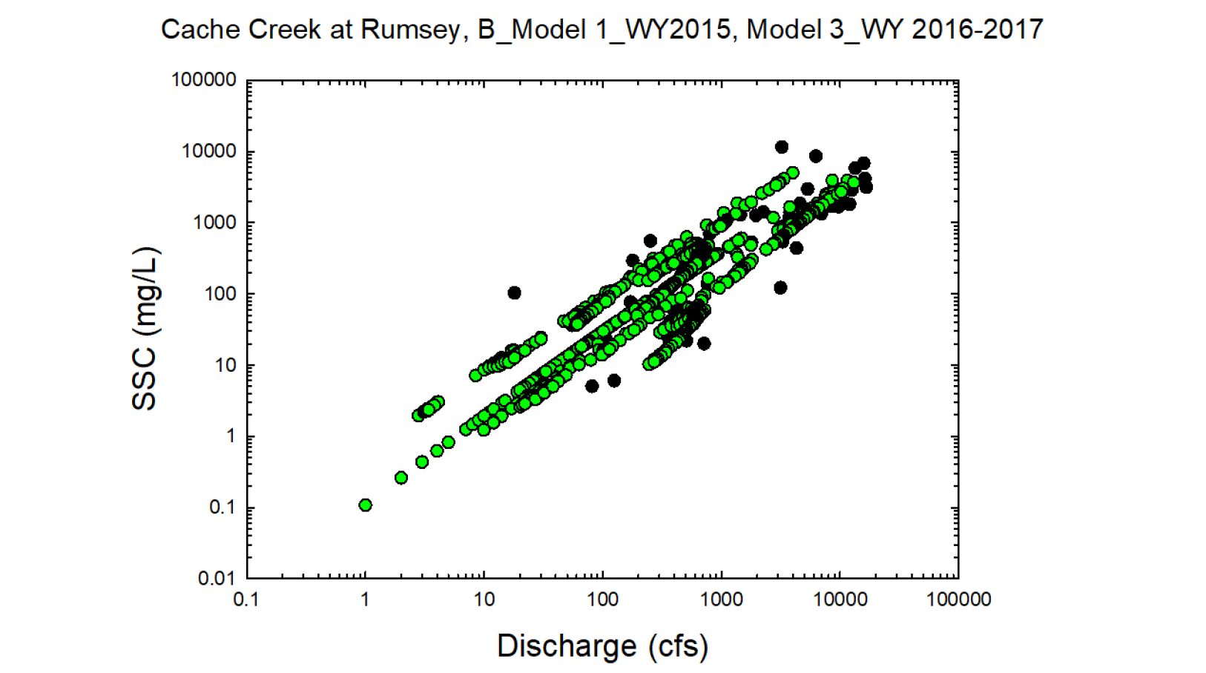
Black circles = Observed values
Green circles = Modeled values

Slide 4
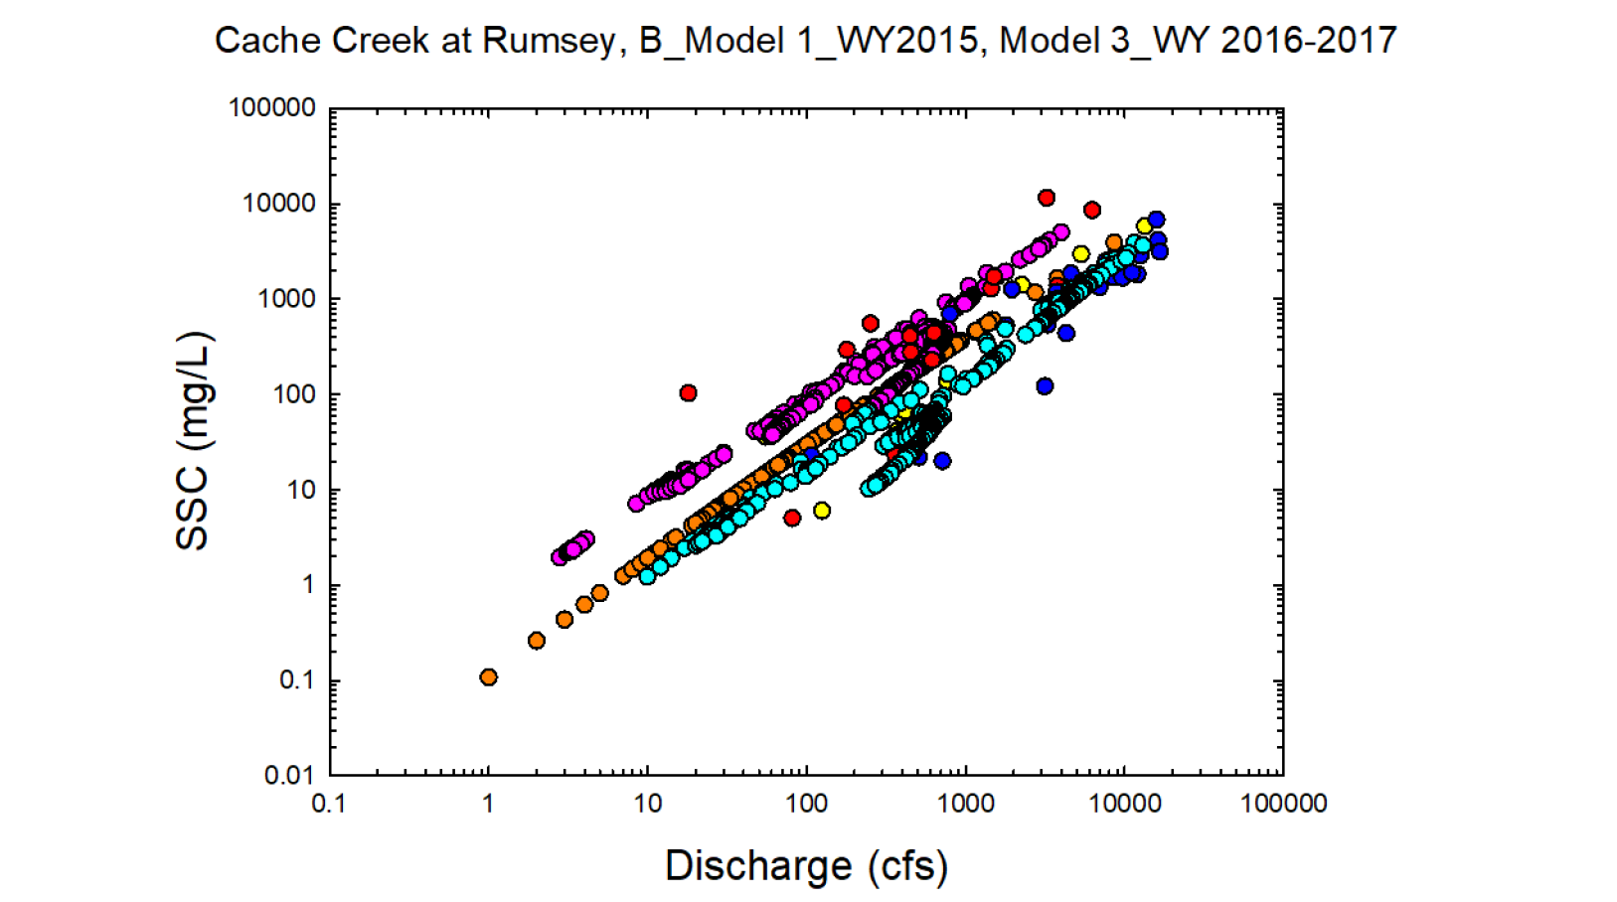
Yellow = Observed wy 2015
Red = Observed wy2016
Dk. Blue = Observed wy2017
Orange = Modeled wy2015
Pink = Modeled wy2016
Lt. Blue= Modeled wy2017

